Slide 1

NBA球隊銷售最佳化
戲劇二 呂紀廷
工工所 洪迎禎
資工三 蔡青邑
電機二 黃宥嘉

Slide 2
我們的目標是讓NBA球隊的收益達到最大
Player Performance 的分析
Player Salary的分析
Player Social Power的分析
NBA ticket Price的分析

Slide 3
Predicting NBA Player Salary Using Player’s Statistics

Slide 4
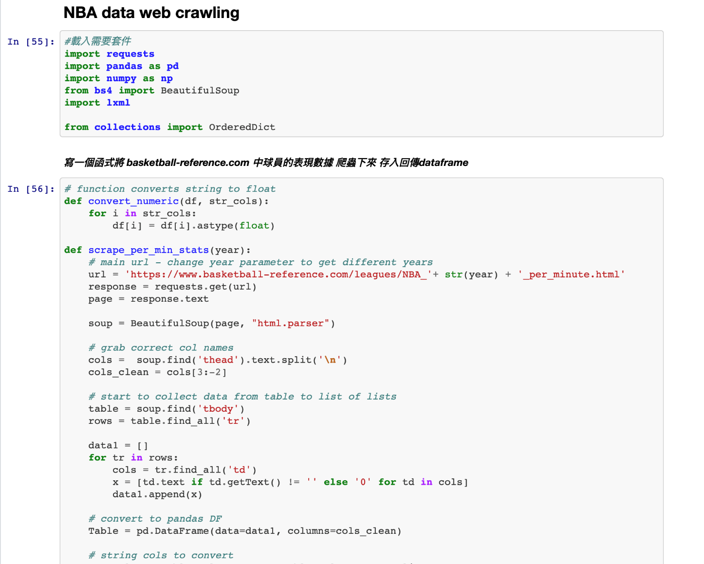
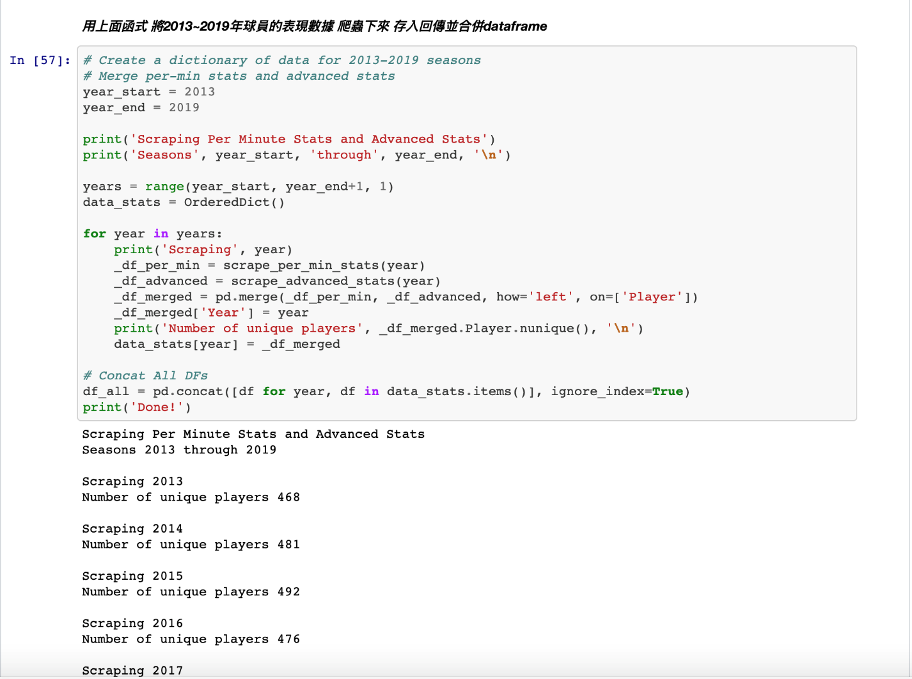
Web Crawling

Slide 5
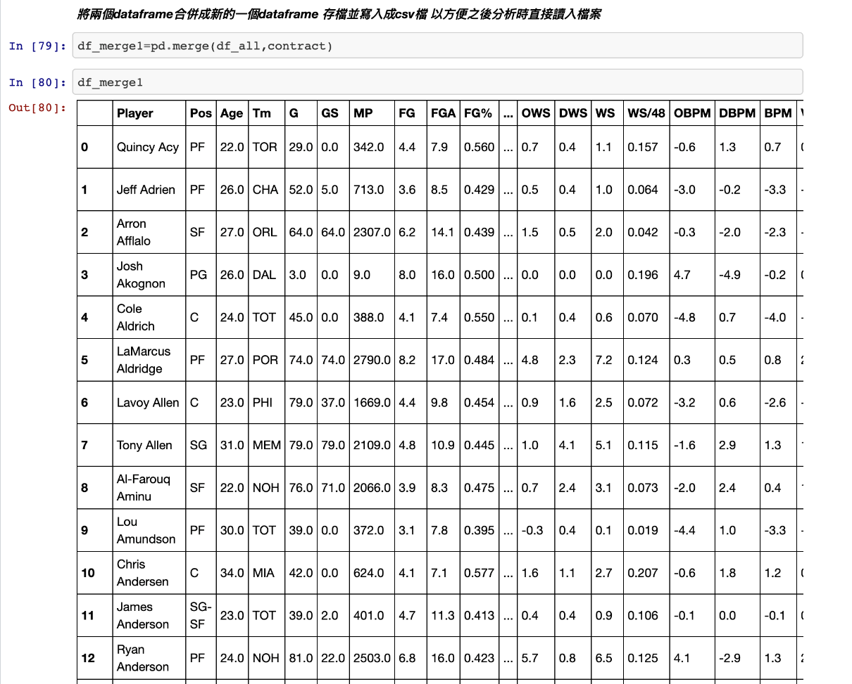
將球員薪水資料和數據表現資料合併
薪水資料從 espn 爬下來
數據資料從 basketball reference爬下來
兩者資料皆從2013年到2019年
最後將兩者資料整理合併
就可以開始準備來分析
薪水以及球員表現之間的關係了！

Slide 6
Business Problem:
Are the players performing at the same level as their salary indicates?
Project Goals:
The purpose of this project is to create a model that uses player statistics to predict a salary.
The Data:
web crawling from basketball-reference.com to get player's performance data for 2013~2019
web crawling from espn.com to get player's salary data for 2013~2019

Slide 7
欄位解釋
SALARY:salary
Player:player
Pos:Position
Age:Age of Player at the start of February 1st of that season.
Tm:Team
G:Games
MP:Minutes Played （＋）
FG:Field Goals Per 36 Minutes （＋）
FGA:Field Goal Attempts Per 36 Minutes
FG% :Field Goal Percentage （＋）
3P :3-Point Field Goals Per 36 Minutes（＋）
3PA :3-Point Field Goal Attempts Per 36 Minutes
3P% : FG% on 3-Pt FGAs.（＋）
2P :2-Point Field Goals Per 36 Minutes（＋）
2PA:2-Point Field Goal Attempts Per 36 Minutes
2P%:FG% on 2-Pt FGAs.（＋）
FT :Free Throws Per 36 Minutes（＋）
FTA : Free Throw Attempts Per 36 Minutes
FT% : Free Throw Percentage（＋）
ORB : Offensive Rebounds Per 36 Minutes（＋）
DRB :Defensive Rebounds Per 36 Minutes（＋）
TRB :Total Rebounds Per 36 Minutes（＋）
AST : Assists Per 36 Minutes（＋）
STL : Steals Per 36 Minutes（＋）
BLK : Blocks Per 36 Minutes（＋）
TOV : Turnovers Per 36 Minutes（-）
PF : Personal Fouls Per 36 Minutes（-）
PTS : Points Per 36 Minutes（＋）
PER:Player Efficiency Rating（＋）
A measure of per-minute production standardized such that the league average is 15.
TS%:True Shooting Percentage（＋）
A measure of shooting efficiency that takes into account 2-point field goals, 3-point field goals, and free throws.
3PAr:3-Point Attempt Rate
Percentage of FG Attempts from 3-Point Range
FTr:Free Throw Attempt Rate
Number of FT Attempts Per FG Attempt
ORB%:Offensive Rebound Percentage
An estimate of the percentage of available offensive rebounds a player grabbed while he was on the floor.
DRB%:Defensive Rebound Percentage
An estimate of the percentage of available defensive rebounds a player grabbed while he was on the floor.
TRB%:Total Rebound Percentage
An estimate of the percentage of available rebounds a player grabbed while he was on the floor.
AST%:Assist Percentage
An estimate of the percentage of teammate field goals a player assisted while he was on the floor.
STL%:Steal Percentage
An estimate of the percentage of opponent possessions that end with a steal by the player while he was on the floor.
BLK%:Block Percentage
An estimate of the percentage of opponent two-point field goal attempts blocked by the player while he was on the floor.
TOV%:Turnover Percentage
An estimate of turnovers committed per 100 plays.
USG%:Usage Percentage
An estimate of the percentage of team plays used by a player while he was on the floor.
OWS:Offensive Win Shares
An estimate of the number of wins contributed by a player due to his offense.
DWS:Defensive Win Shares
An estimate of the number of wins contributed by a player due to his defense.
WS :Win Shares
An estimate of the number of wins contributed by a player.
WS/48 :Win Shares Per 48 Minutes
An estimate of the number of wins contributed by a player per 48 minutes (league average is approximately .100)
OBPM:Offensive Box Plus/Minus
A box score estimate of the offensive points per 100 possessions a player contributed above a league-average player, translated to an average team.
DBPM:Defensive Box Plus/Minus
A box score estimate of the defensive points per 100 possessions a player contributed above a league-average player, translated to an average team.
BPM :Box Plus/Minus
A box score estimate of the points per 100 possessions a player contributed above a league-average player, translated to an average team.
VORP :Value over Replacement Player
A box score estimate of the points per 100 TEAM possessions that a player contributed above a replacement-level (-2.0) player, translated to an average team and prorated to an 82-game season. Multiply by 2.70 to convert to wins over replacement.

Slide 8
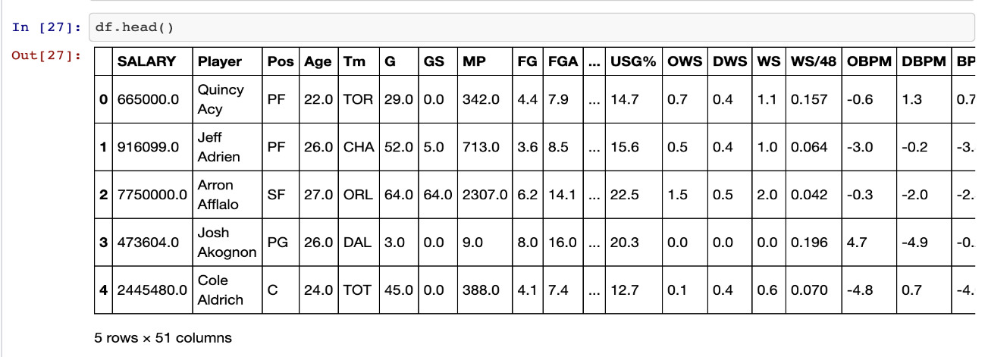
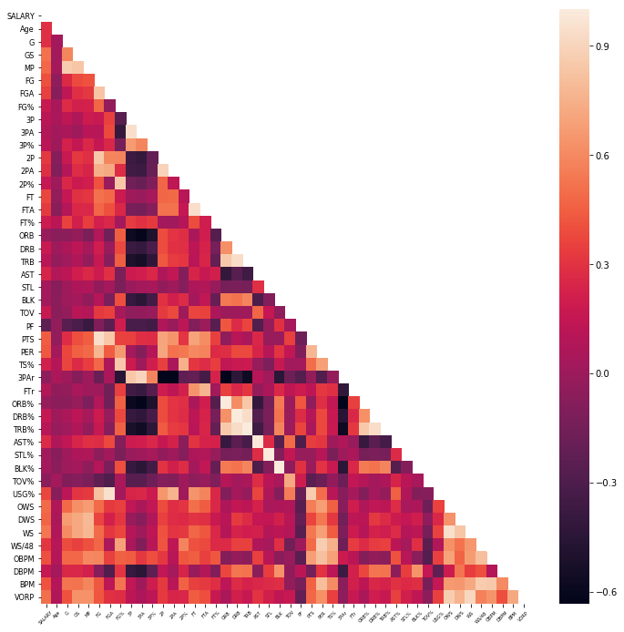
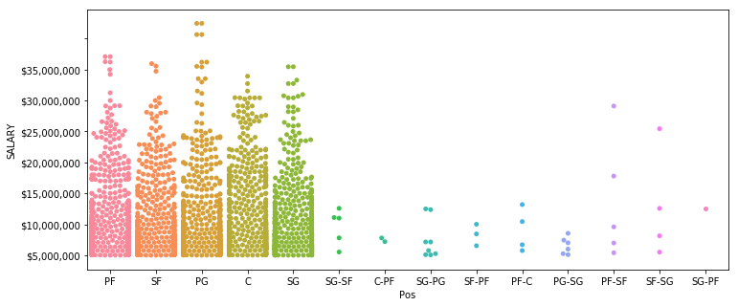
首先探索一下資料間的關係 Exploratory Data Analysis

Slide 9
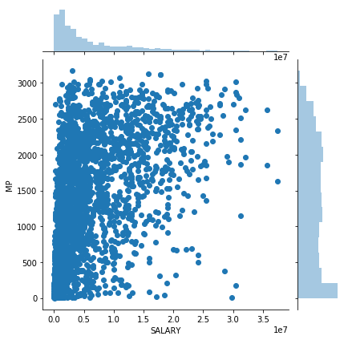
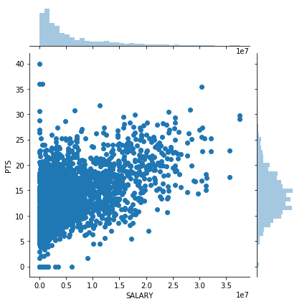
對球員上場時間以及薪水 畫圖 我認為通常一個選手在場上打球越久 代表他可以為球隊帶來比較高的價值 故應該薪水也會較高
可以發現大致仍呈現正相關 然而卻也有許多球員在場上時間很長但薪水也未必較高的情形發生
對球員薪水以及他們的得分表現 畫圖 可以發現大致仍呈現正相關 因此得分仍是一個相當好
可以拿來預測薪水的一項因子

Slide 10
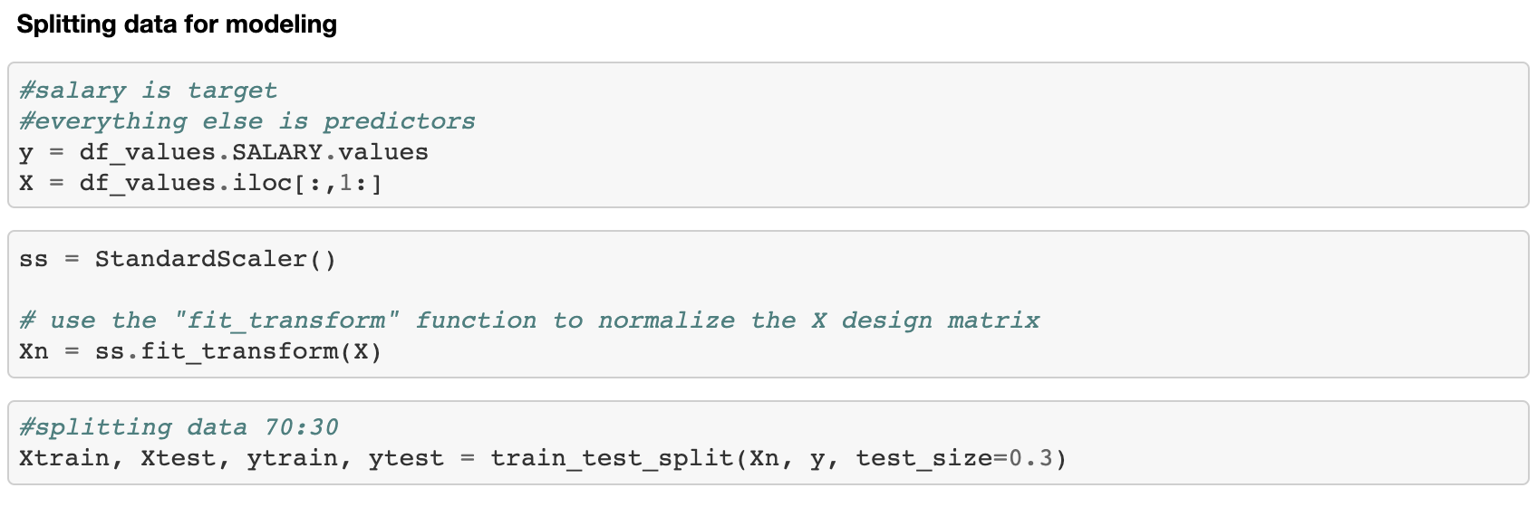
開始套迴歸模型
To start off, I set two variables.
My target variable was Salary and my predictor variable was all the statistical categories.
I then normalized all my predictor variables by using the sklearn.preprocessing.StandardScaler library.
I used the sklearn.model_selection.train_test_split method to subset my data. 70% of my data was used as a training set and the remaining 30% was used as the test set.
I ran 4 different regression models on my data; Linear, Lasso, Ridge, and ElasticNet regression.

Slide 11
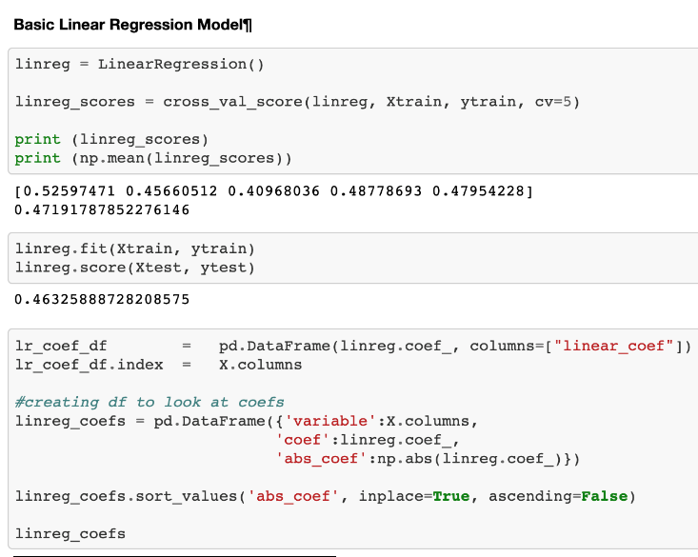
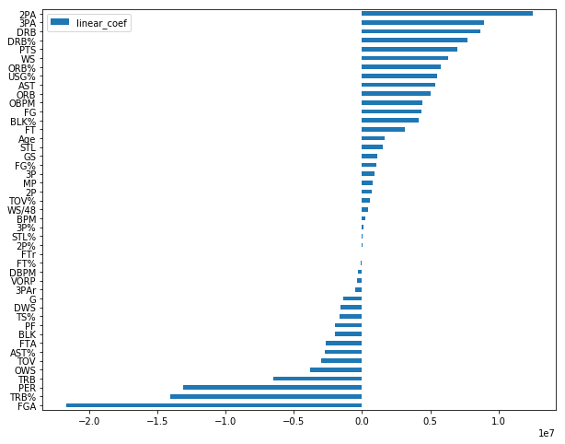
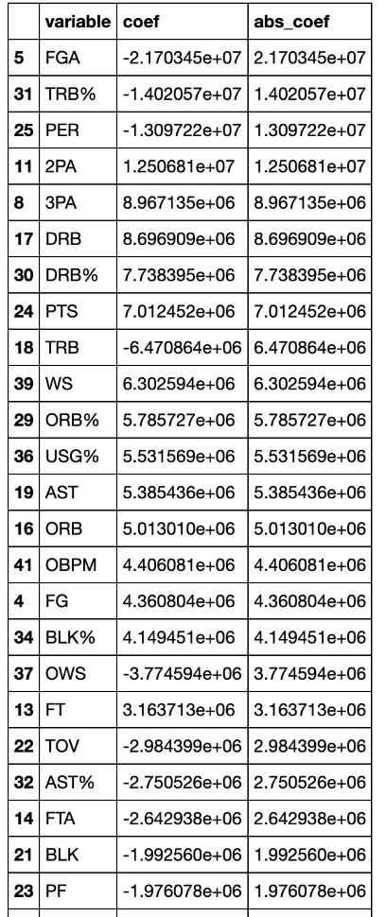
Basic Linear Regression Model
以上圖為 Basic Linear Regression 各係數的作圖 正係數因素主要都被歸到得分相關的種類 雖然有些因素的係數是負的 看似不合理 但 cross validated score 大概有 0.48 也仍算是個表現還可以的模型

Slide 12
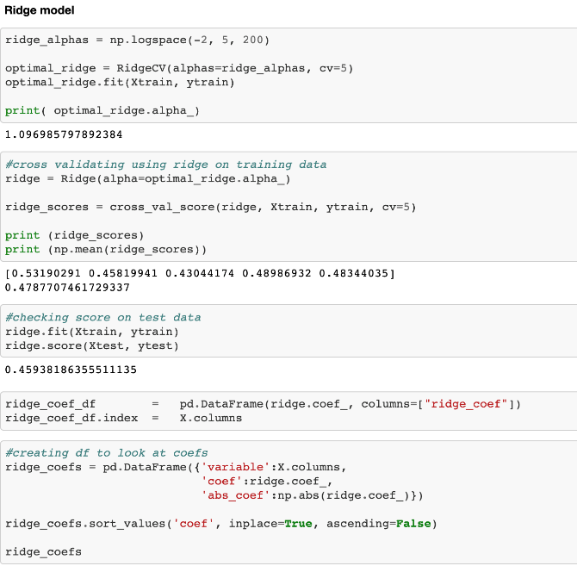
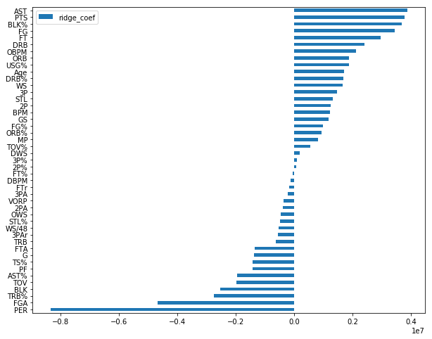
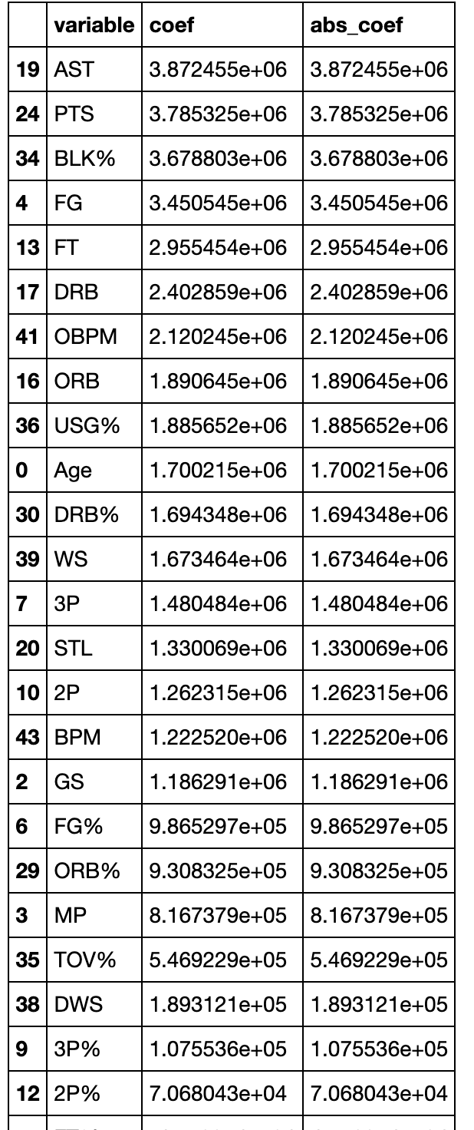
Ridge Model
Ridge regression 似乎對於各因子的權重較平衡一些 例如說籃板 助攻等
The ridge model 表現較符合我們直覺 field goal,助攻,被球隊使用的頻率,火鍋比率,進攻籃板 為正係數的前五名
因為 Rebounds, Assists, and Points 是籃球最主要的三項數據 因此也合理用這些種類表現去預測一個球員的薪水
最後 cross validated score 大概有 0.48 跟basic linear regression表現得差不多
但意思詮釋在我看來 Ridge regression 表現較佳

Slide 13
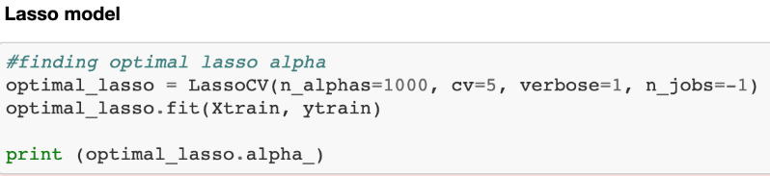
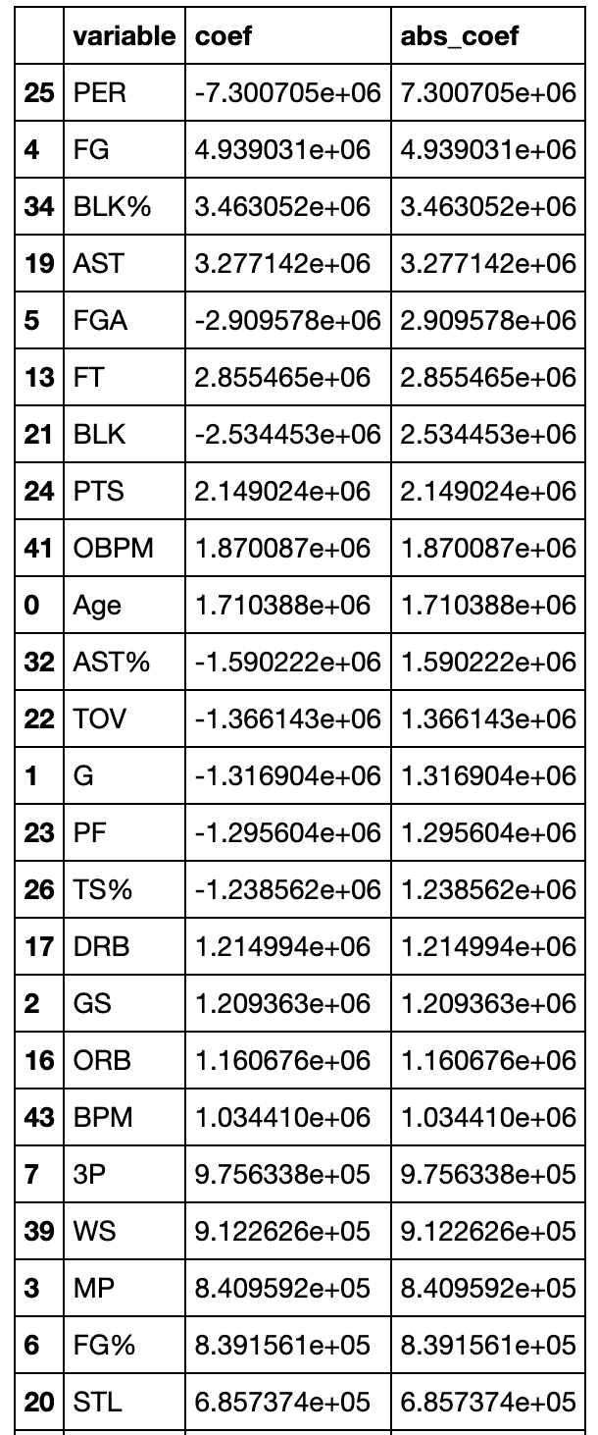
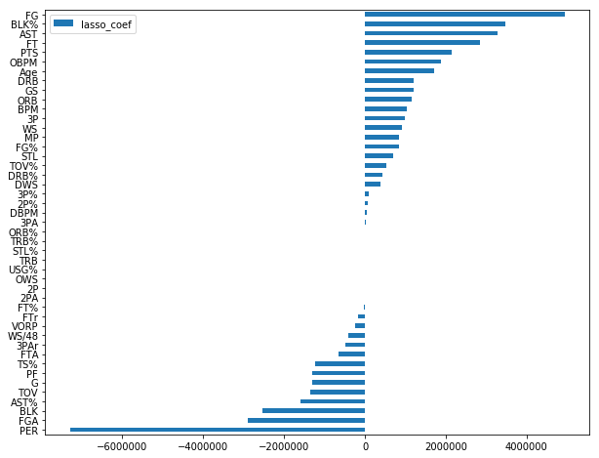
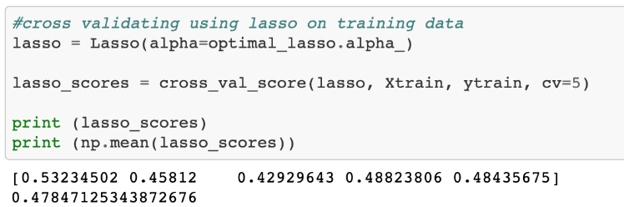
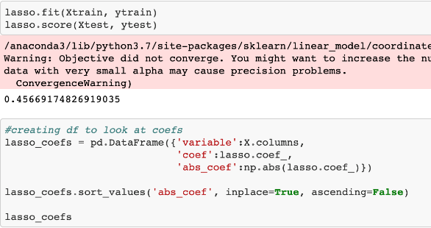
Lasso Model
Lasso regression model 將太多 variables 都變成0了
將15%的種類的詮釋效力都變成0
The lasso model is also performing very similar to the Linear Regression and Ridge models with a score of 0.49.

Slide 14
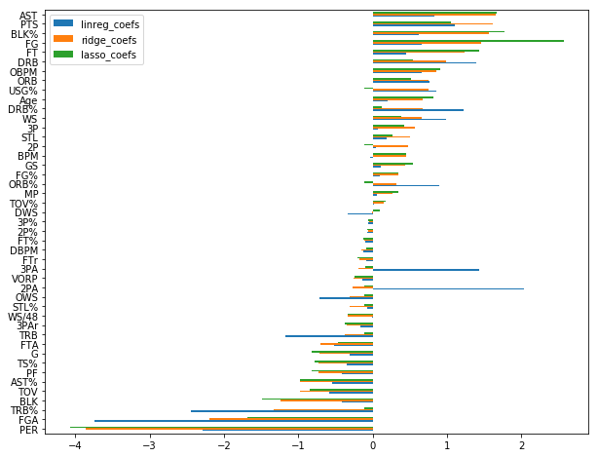
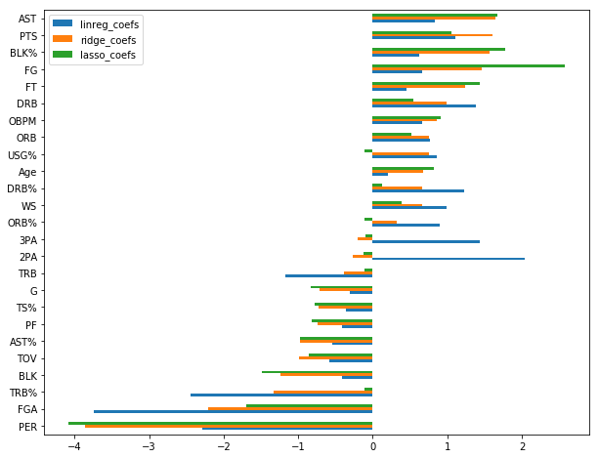
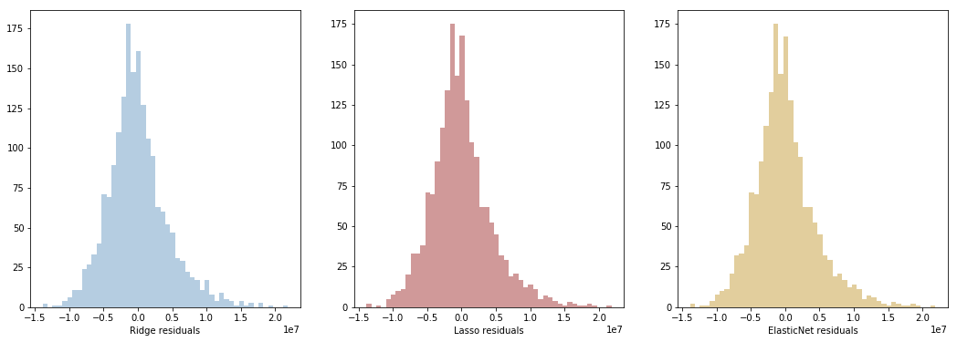
Plotting All My Residuals On One Plot
This plot is showing the weight that each model is putting on the different categories. The bar plot above has been masked to only show the categories where one of the models is weighting a category over 0.75. Categories with weights less than 0.75 are not shown.
My residual plots are all pretty much the same considering my scores were all around the same as well.

Slide 15
Regression Models Summary
All four of the models are scoring around the same with a score of about 0.45.
The ridge regression model makes the most sense intuitively because it is weighting the statistical categories uniformly rather than putting a heavy weight on just one or two categories like the linear regression did.
Also the Ridge handles the multicollinearity of my dataset a lot better than the Lasso does. The ridge weights all the categories appropriately while the Lasso completely zeroes out 15% my predictors, many of which are important to consider when predicting salary.
因此總結我最後用 ridge regression model 來預測球員的薪水

Slide 16
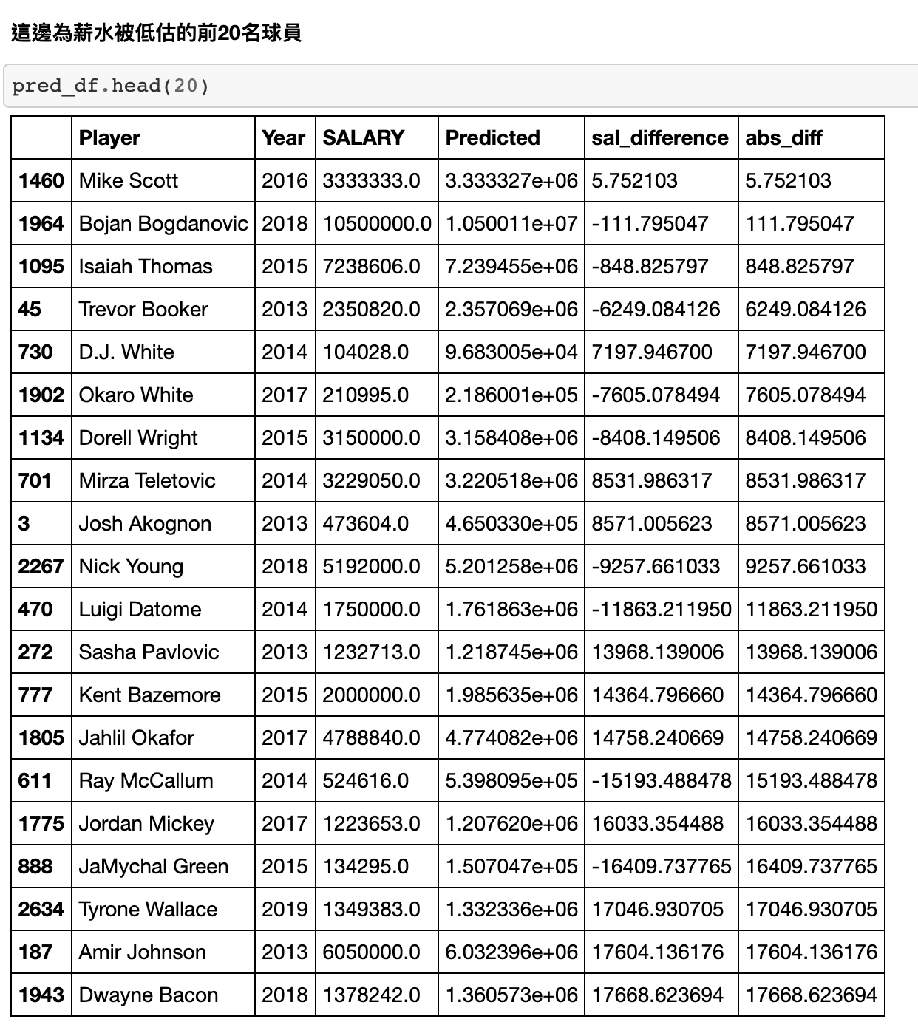
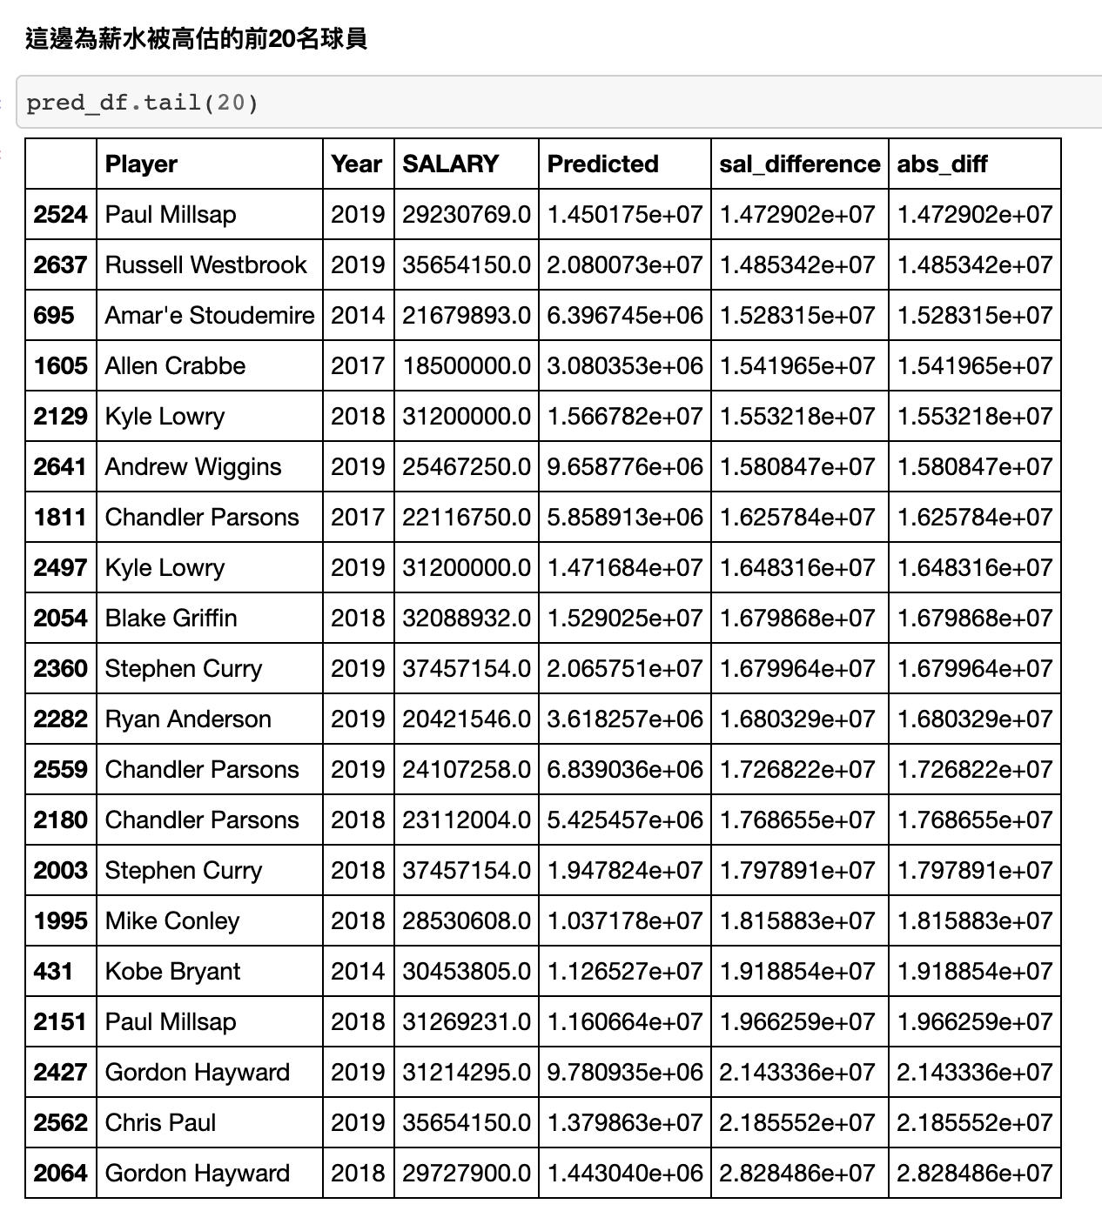
現在來看用模型預測出來薪水被高估以及被低估的球員
Model is performing most accurately on the players who are new to the NBA.
Model is least accurate at predicting salary for players who have been in the NBA for many years and can be considered "super stars"

Slide 17
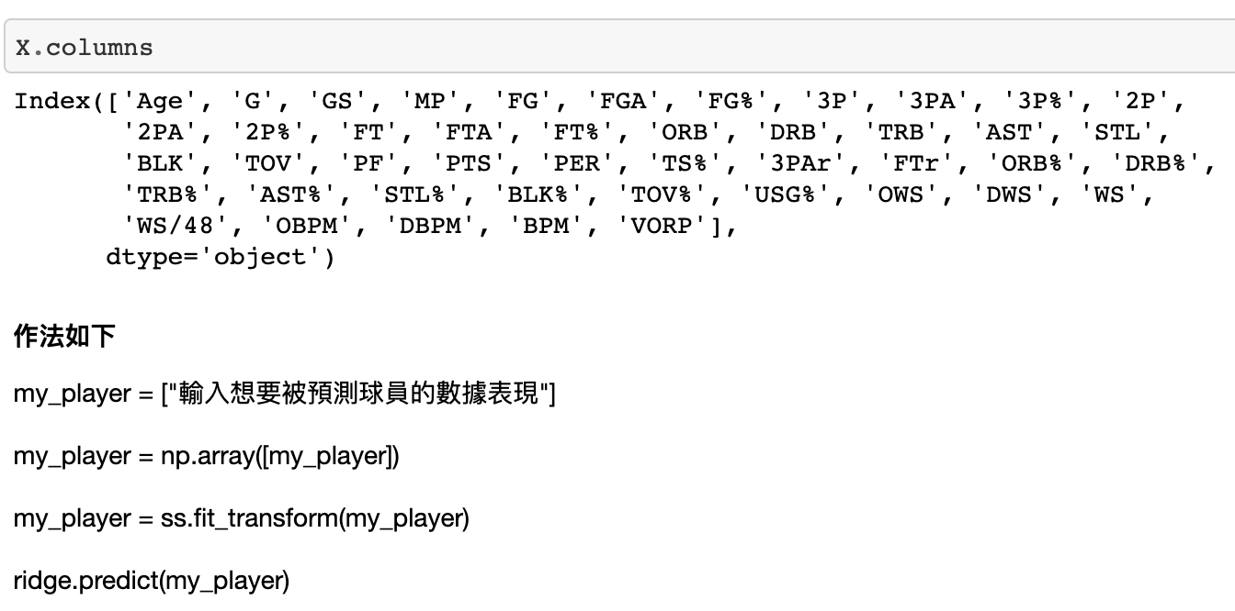
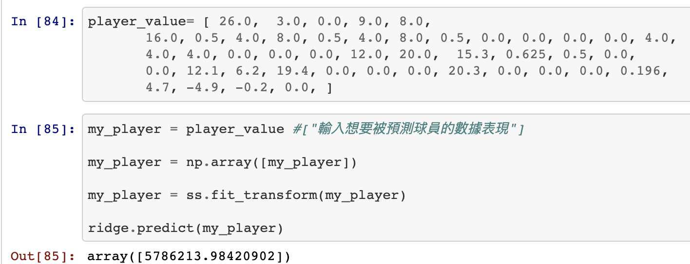
現在我們就可以將一個球員的球場數據輸入到模型裡面 讓模型根據他的表現來預測薪水了
5786213.98420902
是透過模型預測出來
球員的薪水

Slide 18
Social Power

Slide 19
Social Media And Sales
目的:探討社群(以Reddit為例)與球隊銷售之間的關係
Part 1:Reddit數據預測觀眾人數
Part 2:貼文情緒分析
Part 3:球迷習慣分析

Slide 20
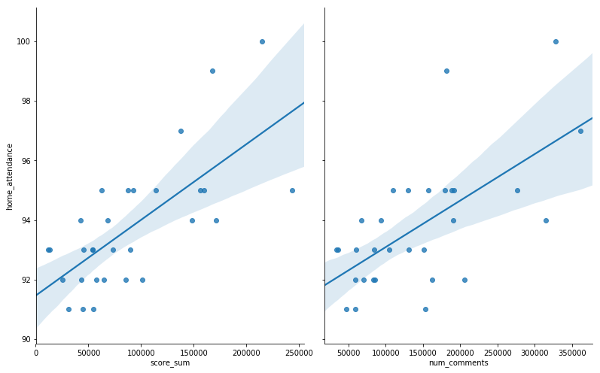
PART1-Reddit數據預測觀眾人數
讚數、回文數和上座率成正相關
各隊讚數、回文數與上座率關係圖(2018-2019球季)

Slide 21
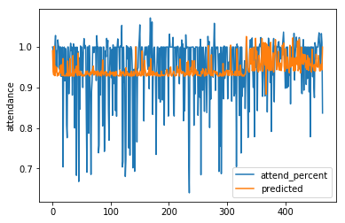
polynomial regression(2018-2019球季)

Slide 22
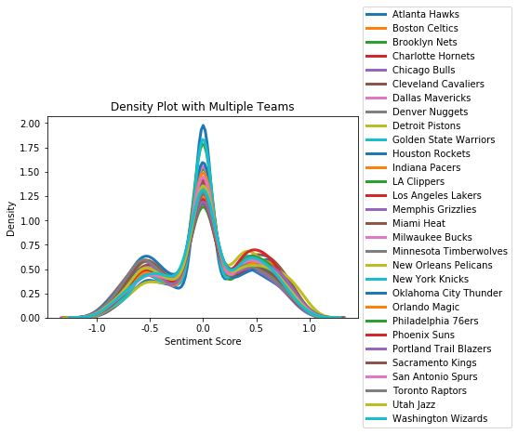
PART2-文章情緒分析
各隊情緒分數分布圖(2018-2019球季)

Slide 23
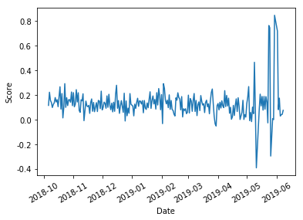
季後賽情緒反應特別大
勇士隊情緒分數折線圖(2018-2019球季)

Slide 24
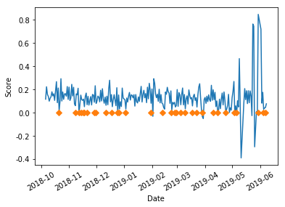
低點都有出現輸球
勇士隊情緒分數折線圖(2018-2019球季)

Slide 25
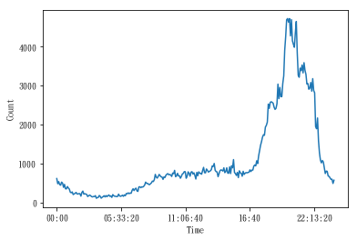
PART3-球迷習慣分析
21:00~22:00為用戶活躍期
各個時間點留言人數(勇士隊)

Slide 26
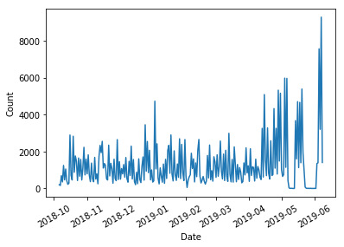
季後賽期間為用戶活躍期
一年間留言人數(勇士隊)

Slide 27
應用
廣告投放
商品銷售

Slide 28
NBA Ticket Price

Slide 29
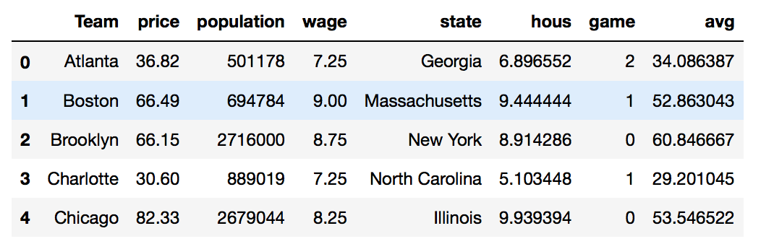
利用不同因素去預測nba的年平均票價
資料來源：
NBA歷年票價
美國各州（包含加拿大多倫多）的最低薪資資料
美國各州（包括加拿大多倫多）的人口資料
歷年NBA勝負資料
資料型態
資料筆數：30*8

Slide 30
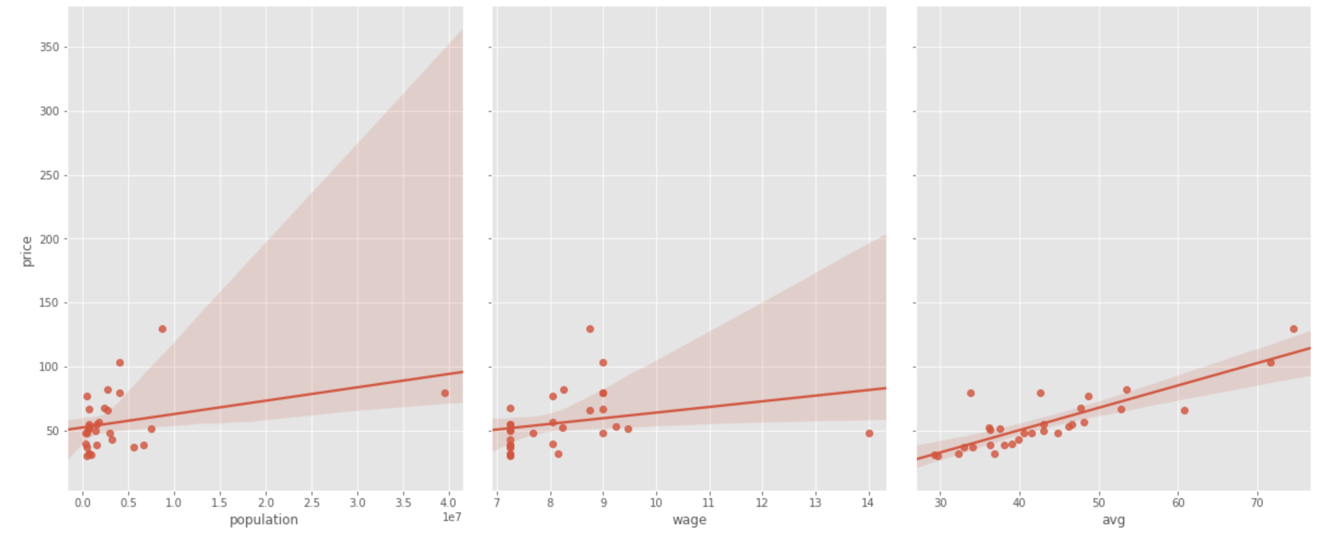
資料eda
可以看過去出票價和人口、最低薪資是有正向關係的

Slide 31
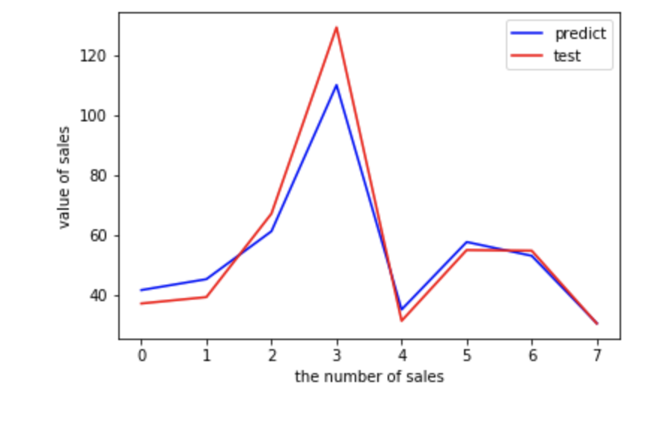
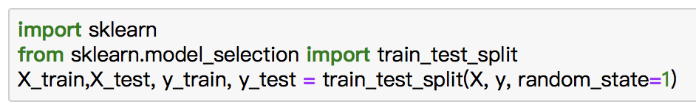
使用線性迴歸
缺點：已經假設因素和結果間有線性關係
套件:python linear regression
變數：最低薪資、人口、過去票價

Slide 32
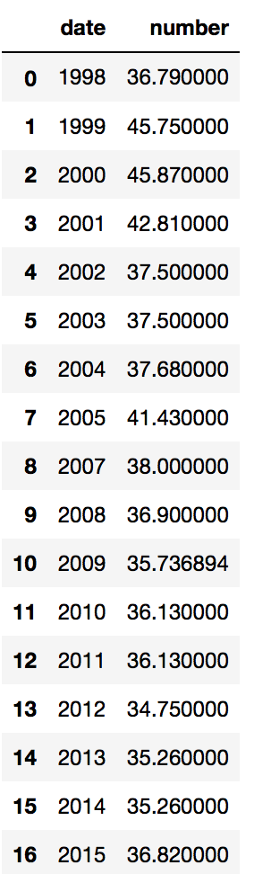
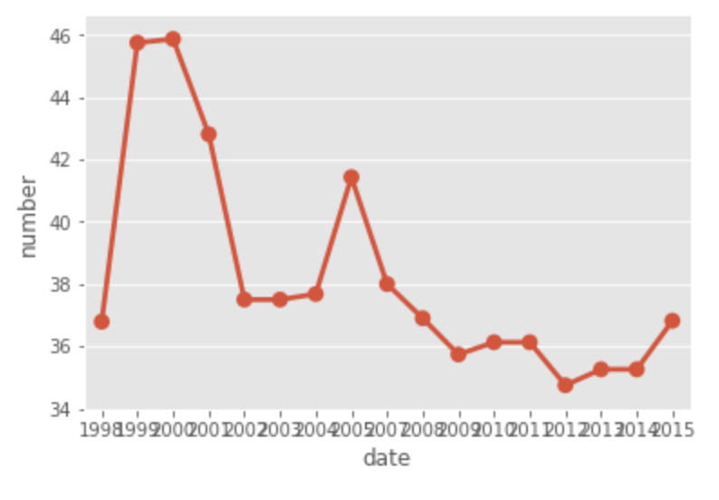
指數平滑法
處理時間序列資料
過往價錢可以解釋大部分的結果，嘗試用指數平滑法單獨利用過往價錢預測未來價格

Slide 33
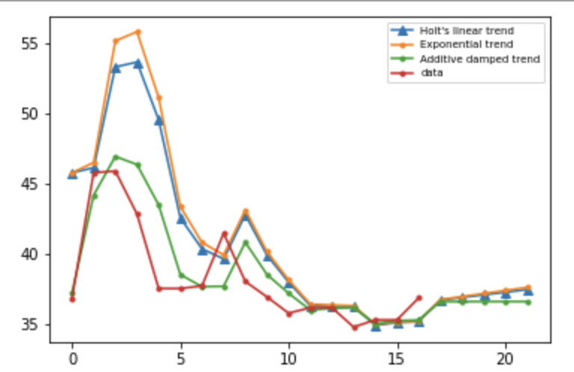
Holt's Method
處理時間序列資料
將不同的時間序列資料處理方法畫在同張圖上，可以看到HOLT-damped方法畫出來的線是最接近現實data的．
Holt 是一種時間序列資料分析法，不同於指數平滑法的地方是，他又稱三次指數平滑法，會考慮趨勢和季節的影響

Slide 34
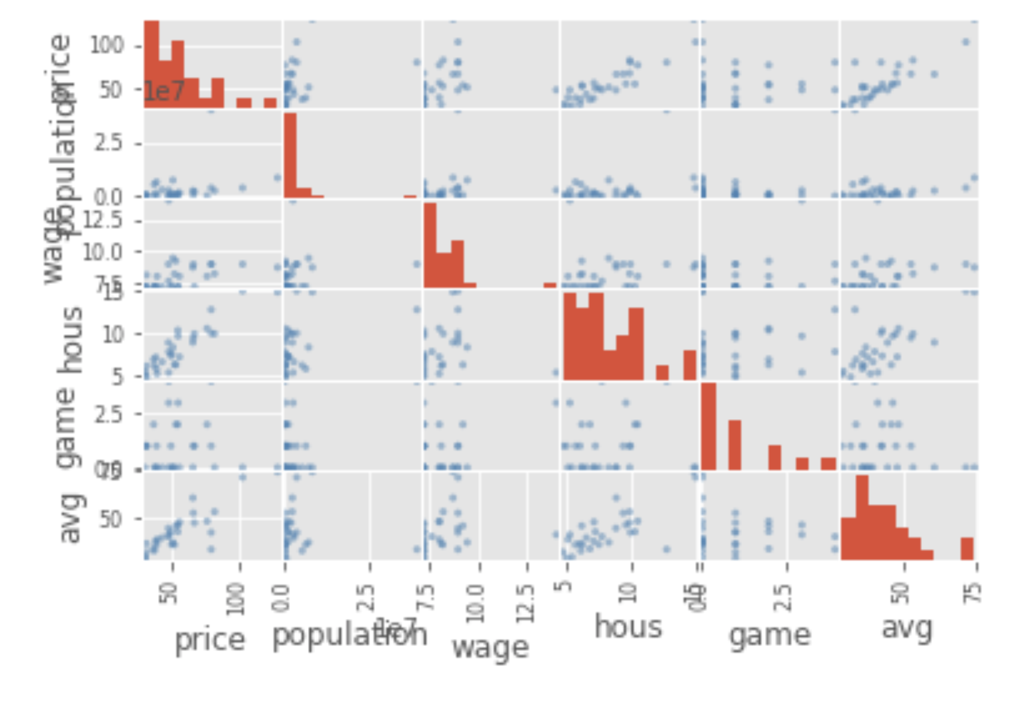
多元迴歸分析
資料散佈圖
主要是看price和各變數之間的變化

Slide 35
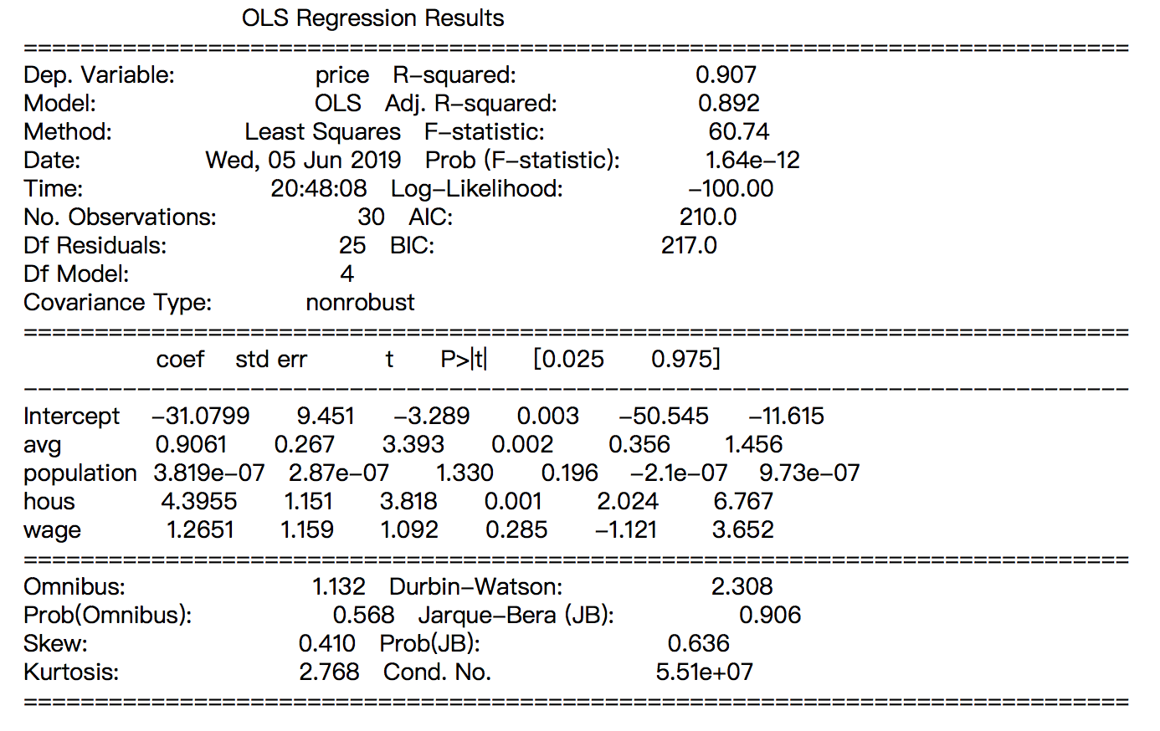
多元迴歸分析
'price~avg +population+hous+wage'
資料散佈圖

Slide 36
DNN & RNN
(with ticket price, team performance, ticket sales)

Slide 37
預測售票銷售收入
資料來源：
NBA各隊歷年票價
NBA各隊歷年勝率
NBA各隊各年售票情形
NBA各年MVP所在隊伍
資料年份：2000~2017

Slide 38
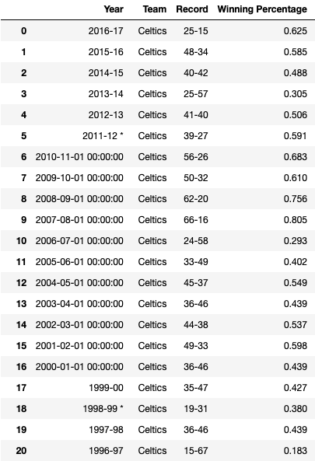
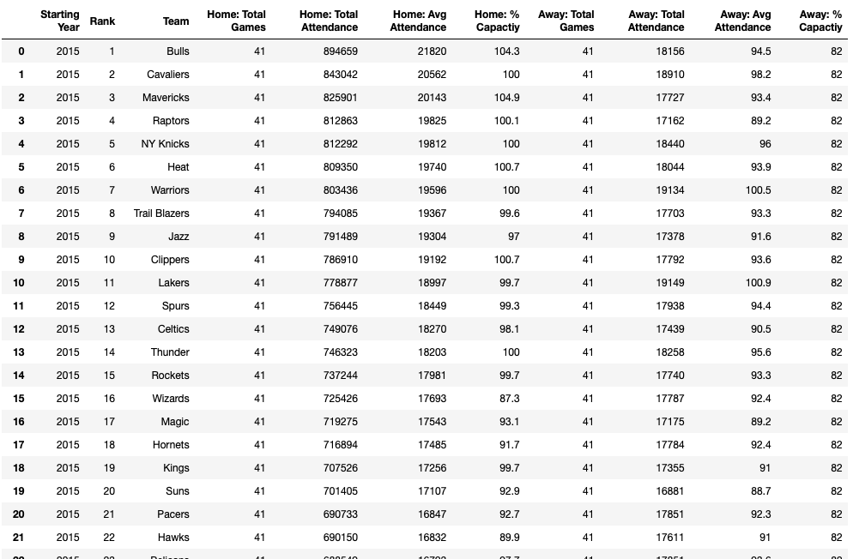
資料型態

Slide 39
預測目標
售票銷售收入：
沒有data?
當年度 平均票價 * 票價銷量

Slide 40
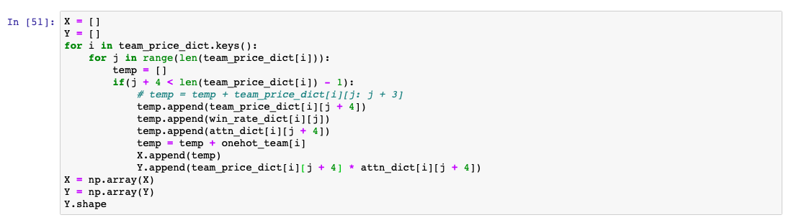
DNN 模型：input
票價與銷售情形的時間序列：前三年的數據
MVP所在隊伍
隊伍的one-hot encoding
隊伍前一年勝率

Slide 41
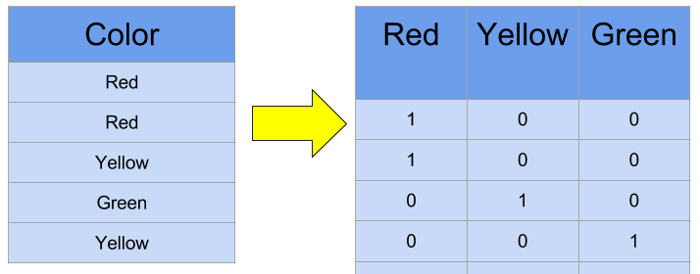
DNN 模型：One-hot encoding

Slide 42
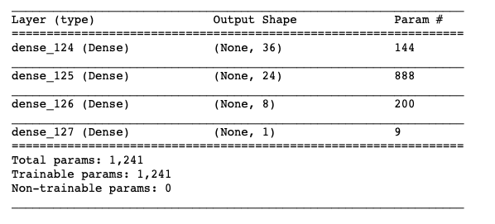
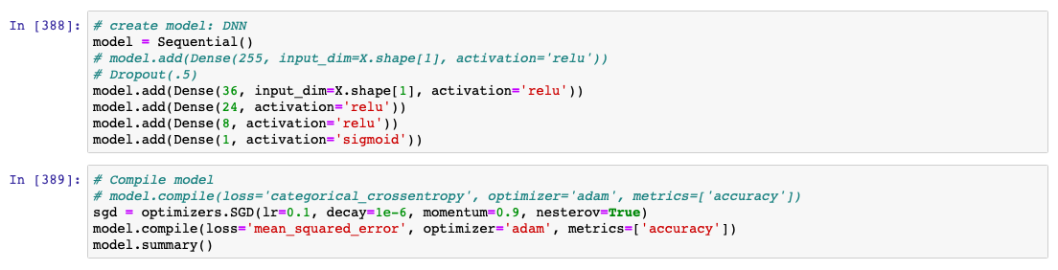
DNN 模型：架構

Slide 43
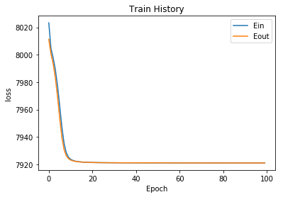
DNN 模型：結果

Slide 44
RNN 模型：input
票價與銷售情形的時間序列：前五年的數據
MVP所在隊伍
隊伍的one-hot encoding
隊伍前一年勝率

Slide 45


RNN 模型：架構

Slide 46

RNN 模型：結果

Slide 47
可以改進的地方
Data augmentation
one-hot encoding -> team infos
Model selection and merging

Slide 48
Conclusion

Slide 49
Q & A

